Slide 1
Homework Unit 4
Ran Cheng 27720161153019
WISE Master of Finance

Slide 2
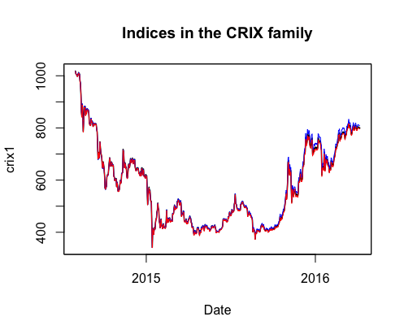
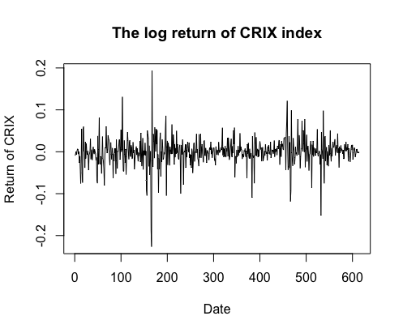
Q1. Improve the R quantlets on GH (from CRIX directory on quantlet.de) and make excellent graphics that follow Fig 3,4,5,6 of the ”Econometrics of CRIX“ paper.
Figure 3: The daily value of indices in the CRIX family
Figure 4: The log returns of CRIX index

Slide 3
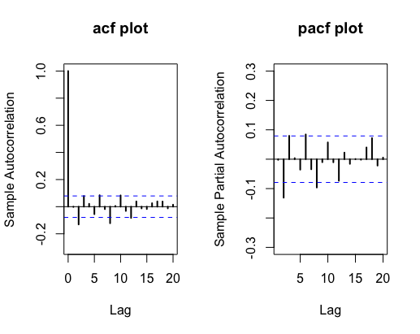
Figure 5: Histogram and QQ plot of CRIX returns
Figure 6: The sample ACF and PACF of CRIX returns
rm(list = ls(all = TRUE))
graphics.off()
# install and load packages
libraries = c("zoo", "tseries", "xts","ccgarch")
lapply(libraries, function(x) if (!(x %in% installed.packages())) { install.packages(x)}

Slide 4
lapply(libraries, library, quietly = TRUE, character.only = TRUE)
# load dataset
load(file.choose())
load(file.choose())
load(file.choose())
# three indices return
ecrix1 = zoo(ecrix, order.by = index(crix1))
efcrix1 = zoo(efcrix, order.by = index(crix1))
# plot with different x-axis scales with zoo
my.panel <- function(x, ...) {
lines(x, ...)
lines(ecrix1, col = "blue")
lines(efcrix1, col = "red")
}
plot.zoo(crix1, plot.type = "multiple", type = "l", lwd = 1.5, panel = my.panel,
main = "Indices in the CRIX family", xlab = "Date")

Slide 5
# plot of crix
# plot(as.xts(crix), type="l", auto.grid=FALSE, main = NA)
plot(crix1, ylab = "Price of CRIX", xlab = "Date")
# plot of crix return
ret = diff(log(crix1))
# plot(as.xts(ret), type="l", auto.grid=FALSE, main = NA)
plot(ret, ylab = "Return of CRIX", xlab = "Date")
# stationary test
adf.test(ret, alternative = "stationary")
kpss.test(ret, null = "Trend")
par(mfrow = c(1, 2))
# histogram of returns
hist(ret, col = "grey", breaks = 20, freq = FALSE, ylim = c(0, 25), xlab = "Return of CRIX")
lines(density(ret), lwd = 2)
mu = mean(ret)
sigma = sd(ret)
x = seq(-4, 4, length = 100)
curve(dnorm(x, mean = mean(ret), sd = sd(ret)), add = TRUE, col = "red",
lwd = 2)

Slide 6
# qq-plot
qqnorm(ret)
qqline(ret, col = "blue", lwd = 3)
# acf plot
autocorr = acf(ret, lag.max = 20, ylab = "Sample Autocorrelation", main = "acf plot",
lwd = 2, ylim = c(-0.3, 1))
# pacf plot
autopcorr = pacf(ret, lag.max = 20, ylab = "Sample Partial Autocorrelation",
main = "pacf plot", ylim = c(-0.3, 0.3), lwd = 2)

Slide 7
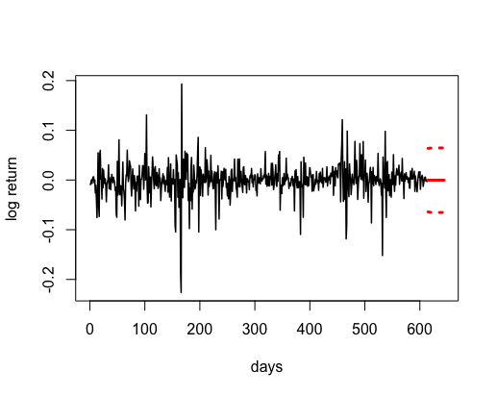
Q2. Make your R code perfect as in the R examples on quantlet.de i.e. make sure that the
code is ”time independent“ by using actual dimensions of the data that you are collecting
from crix.hu-berlin.de Recreate Fig 7 from ”Econometrics of CRIX“.
Figure 7: CRIX returns and predicted values.

Slide 8
Codes:
# arima model
par(mfrow = c(1, 1))
fit1 = arima(ret, order = c(1, 0, 1))
tsdiag(fit1)
Box.test(fit1$residuals, lag = 1)
# aic
aic = matrix(NA, 6, 6)
for (p in 0:4) {
for (q in 0:3) {
a.p.q = arima(ret, order = c(p, 0, q))
aic.p.q = a.p.q$aic
aic[p + 1, q + 1] = aic.p.q
}
}
# bic
bic = matrix(NA, 6, 6)
for (p in 0:4) {
for (q in 0:3) {
b.p.q = arima(ret, order = c(p, 0, q))
bic.p.q = AIC(b.p.q, k = log(length(ret)))
bic[p + 1, q + 1] = bic.p.q
}
}
# select p and q order of ARIMA model
fit4 = arima(ret, order = c(2, 0, 3))
tsdiag(fit4)
Box.test(fit4$residuals, lag = 1)
fitr4 = arima(ret, order = c(2, 1, 3))
tsdiag(fitr4)
Box.test(fitr4$residuals, lag = 1)

Slide 9
# to conclude, 202 is better than 213
fit202 = arima(ret, order = c(2, 0, 2))
AIC(fit202, k = log(length(ret)))
AIC(fit4, k = log(length(ret)))
AIC(fitr4, k = log(length(ret)))
fit202$aic
fit4$aic
fitr4$aic
# arima202 predict
predict_num = 30
fit202 = arima(ret, order = c(2, 0, 2))
crpre = predict(fit202, n.ahead = predict_num)
dates = seq(as.Date("02/08/2014", format = "%d/%m/%Y"), by = "days", length = length(ret))
plot(ret, type = "l", xlim = c(0, length(ret)+predict_num), ylab = "log return", xlab = "days",
lwd = 1.5, col = "black")
lines(crpre$pred, col = "red", lwd = 3)
lines(crpre$pred + 2 * crpre$se, col = "red", lty = 3, lwd = 3)
lines(crpre$pred - 2 * crpre$se, col = "red", lty = 3, lwd = 3)

Slide 10
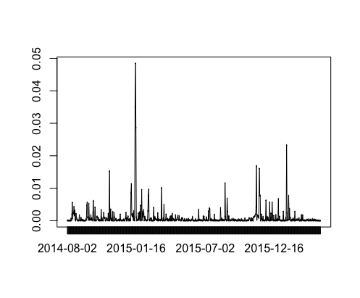
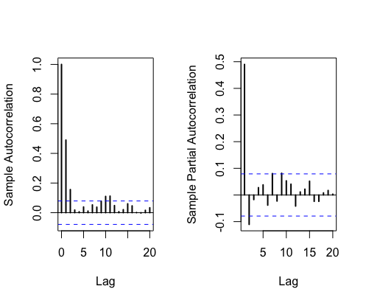
Q3. Redo as many ﬁgures as you can.
Figure 8: The squared ARIMA(2,0,2) residuals of CRIX returns.
Figure 9: The ACF and PACF of squared ARIMA(2,0,2) residuals

Slide 11
Codes:
rm(list = ls(all = TRUE))
graphics.off()
# install and load packages
libraries = c("tseries")
lapply(libraries, function(x) if (!(x %in% installed.packages())) {
install.packages(x)
})
lapply(libraries, library, quietly = TRUE, character.only = TRUE)
# please change your working directory
setwd()
load(file.choose())
Pr = as.numeric(crix)
Da = factor(date1)
crx = data.frame(Da, Pr)
# plot of crix return
ret = diff(log(crx$Pr))
Dare = factor(date1[-1])
retts = data.frame(Dare, ret)
# arima202 predict
fit202 = arima(ret, order = c(2, 0, 2))
# vola cluster
par(mfrow = c(1, 1))
res = fit202$residuals
res2 = fit202$residuals^2
tsres202 = data.frame(Dare, res2)
plot(tsres202$Dare, tsres202$res2, type = "o", ylab = NA)
lines(tsres202$res2)
# plot(res2, ylab='Squared residuals', main=NA)
par(mfrow = c(1, 2))
acfres2 = acf(res2, main = NA, lag.max = 20, ylab = "Sample Autocorrelation", lwd = 2)
pacfres2 = pacf(res2, lag.max = 20, ylab = "Sample Partial Autocorrelation", lwd = 2, main = NA)

Slide 12
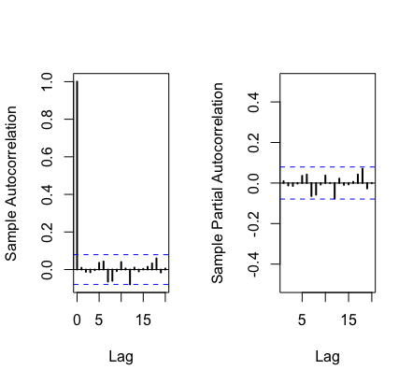
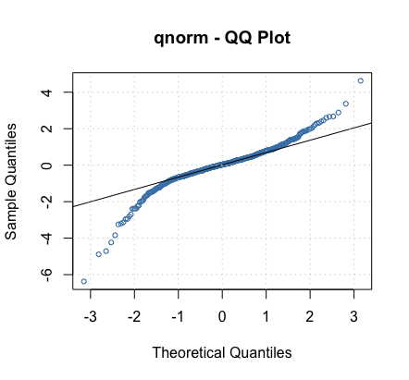
Figure 10: The ACF and PACF of squared ARIMA(2,0,2) residuals
Figure 11: The QQ plots of model residuals of ARIMA-GARCH process.

Slide 13
Codes:
rm(list = ls(all = TRUE))
graphics.off()
# install and load packages
libraries = c("forecast", "fGarch")
lapply(libraries, function(x) if (!(x %in% installed.packages())) {
install.packages(x)
})
lapply(libraries, library, quietly = TRUE, character.only = TRUE)
# load dataset
load(file.choose())
ret = diff(log(crix1))
# vol cluster
fit202 = arima(ret, order = c(2, 0, 2))
par(mfrow = c(1, 1))
res = fit202$residuals
res2 = fit202$residuals^2
# different garch model
fg11 = garchFit(data = res, data ~ garch(1, 1))
summary(fg11)
fg12 = garchFit(data = res, data ~ garch(1, 2))
summary(fg12)
fg21 = garchFit(data = res, data ~ garch(2, 1))
summary(fg21)
fg22 = garchFit(data = res, data ~ garch(2, 2))
summary(fg22)
# residual plot
reszo = zoo(fg11@residuals, order.by = index(crix1))
plot(reszo, ylab = NA, lwd = 2)

Slide 14
par(mfrow = c(1, 2))
fg11res2 = fg11@residuals
acfres2 = acf(fg11res2, lag.max = 20, ylab = "Sample Autocorrelation",
main = NA, lwd = 2)
pacfres2 = pacf(fg11res2, lag.max = 20, ylab = "Sample Partial Autocorrelation",
main = NA, lwd = 2, ylim = c(-0.5, 0.5))
fg12res2 = fg12@residuals
acfres2 = acf(fg12res2, lag.max = 20, ylab = "Sample Autocorrelation",
main = NA, lwd = 2)
pacfres2 = pacf(fg12res2, lag.max = 20, ylab = "Sample Partial Autocorrelation",
main = NA, lwd = 2, ylim = c(-0.5, 0.5))
# qq plot
par(mfrow = c(1, 1))
plot(fg11, which = 13) #9,10,11,13

Slide 15
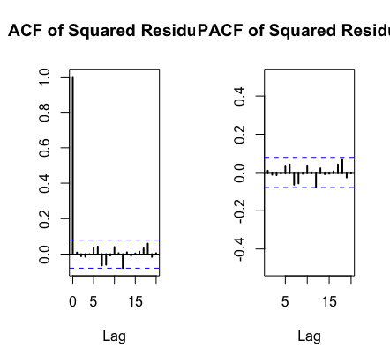
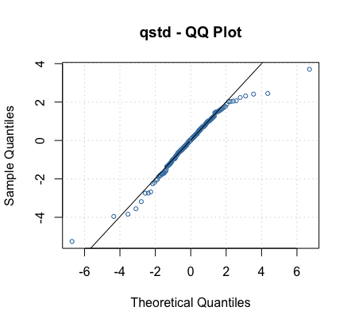
Figure 12: The ACF and PACF plots for model residuals of ARIMA(2,0,2)- t-GARCH(1,1) process.
Figure 13: The QQ plots of model residuals of ARIMA-t-GARCH process.

Slide 16
Codes:
fg11stu = garchFit(data = res, data ~ garch(1, 1), cond.dist = "std")
# different forecast with t-garch
# fg11stufore = predict(fg11stu, n.ahead = 30, plot=TRUE, mse='uncond', auto.grid=FALSE)
fg11stufore = predict(fg11stu, n.ahead = 30, plot = TRUE, cond.dist = "QMLE",
auto.grid = FALSE)
par(mfrow = c(1, 2))
stu.fg11res2 = fg11stu@residuals
# acf and pacf for t-garch
stu.acfres2 = acf(stu.fg11res2, ylab = NA, lag.max = 20, main = "ACF of Squared Residuals",
lwd = 2)
stu.pacfres2 = pacf(stu.fg11res2, lag.max = 20, main = "PACF of Squared Residuals",
lwd = 2, ylab = NA, ylim = c(-0.5, 0.5))
# ARIMA-t-GARCH qq plot
par(mfrow = c(1, 1))
plot(fg11stu, which = 13)

